Slide 1


School management Web application
Md Shahduzzaman
2131297@iub.edu.bd

Slide 2

TESL Portal
Teaching English as a Second Language
Md Shahduzzaman
2131297@iub.edu.bd
Department of Computer Science and Engineering,
Independent University of Bangladesh.

Slide 3
Problem Statement
To prevent spelling errors during board exam registration, this system ensures that all student data is readily accessible with a single click.
This problem is a human error.
Pain point:
My certificate name and date of birth are completely different from my actual details, which has caused me significant difficulties in getting them updated. As of now, the updates have been completed up to my SSC records, but the rest are still pending.

Slide 4
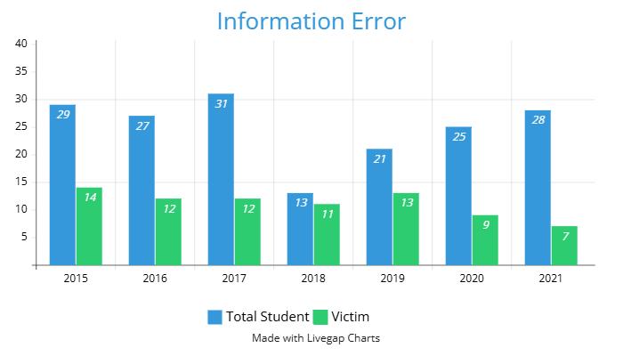

Slide 5
Solution
This portal provides instant access to all student data, ensuring that errors during registration are significantly minimized.
This project addresses the critical need for accurate and streamlined student data management by integrating features such as attendance tracking, payment processing, classwork updates, and leave application submissions. It offers a comprehensive solution to enhance efficiency and reduce errors in the education sector.
In the 21st century, the age of information and communication technology, this is the ideal time to develop this system to stay aligned with current advancements and remain up-to-date.

Slide 6
System works for:
System user:
Students Data,
Attendance record,
Tuition fees record,
Classwork posting.
Students,
Teacher,
Moderators,
Accountant.

Slide 7
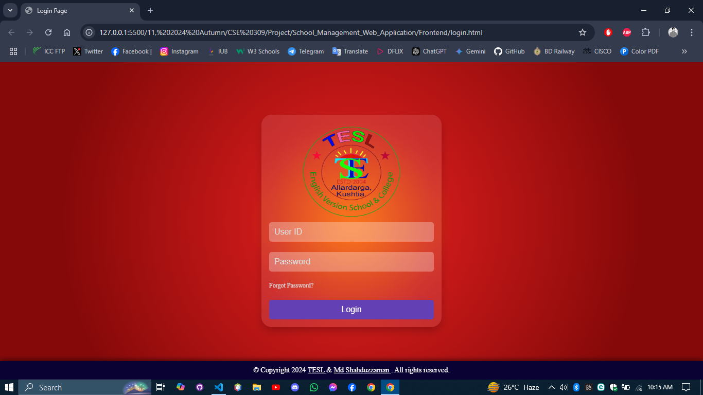

Slide 8
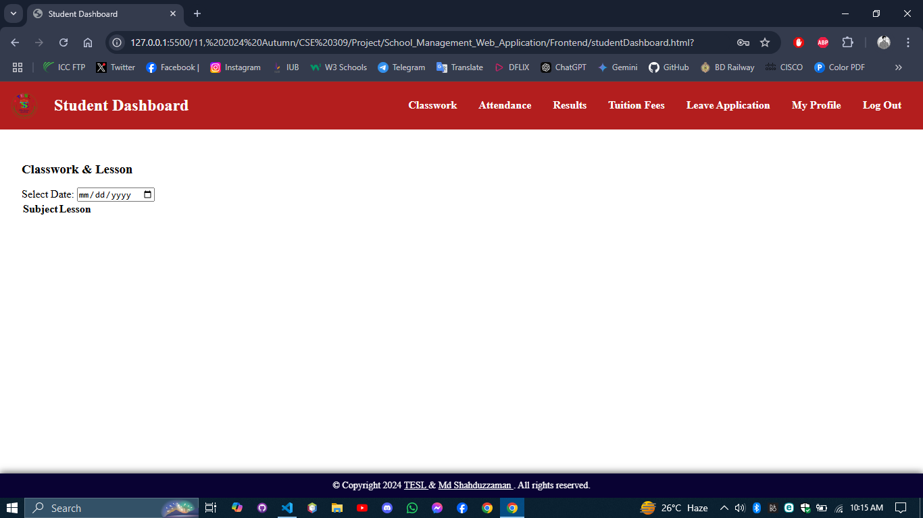
Classwork: The assigned class will be connected to the dashboard and assigned subjects to that class will appear here in the table with columns of Subject and Lesson. Before the table there will be a date picker (loaded with current date) so that the students can check the previous day’s lesson.
Footer: Same footer for all the dashboard of the system.

Slide 9
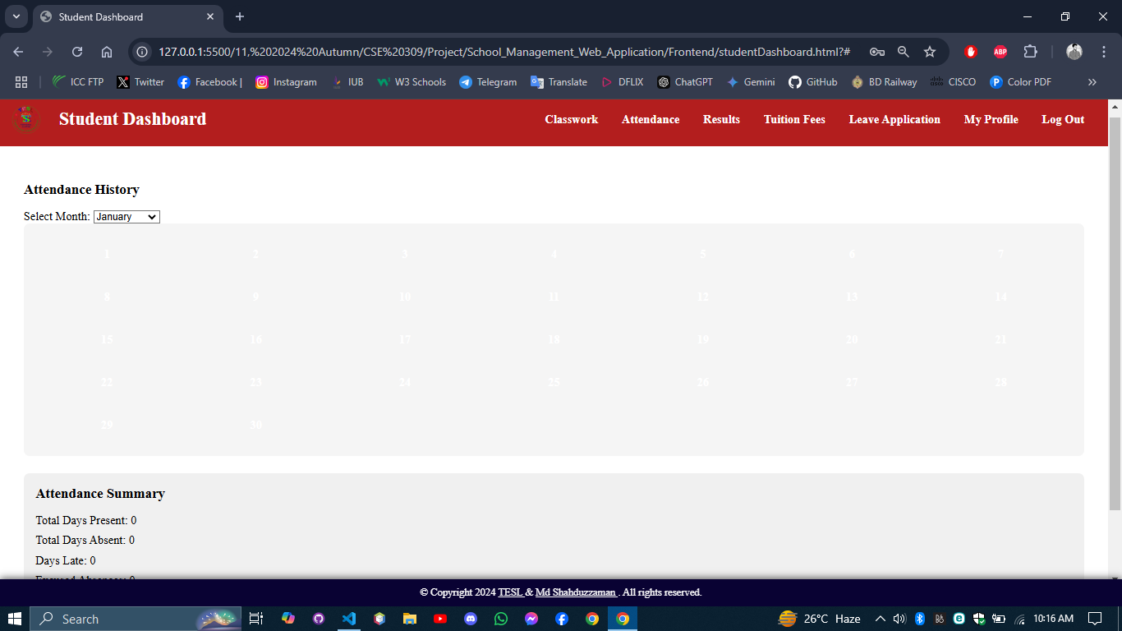
Attendance: A dropdown selection box to select the month(current month will be preloaded). Then there will be a calendar like table where the present days will be green and absent will be red filled box. The weekly holydays will be ash colored.

Slide 10
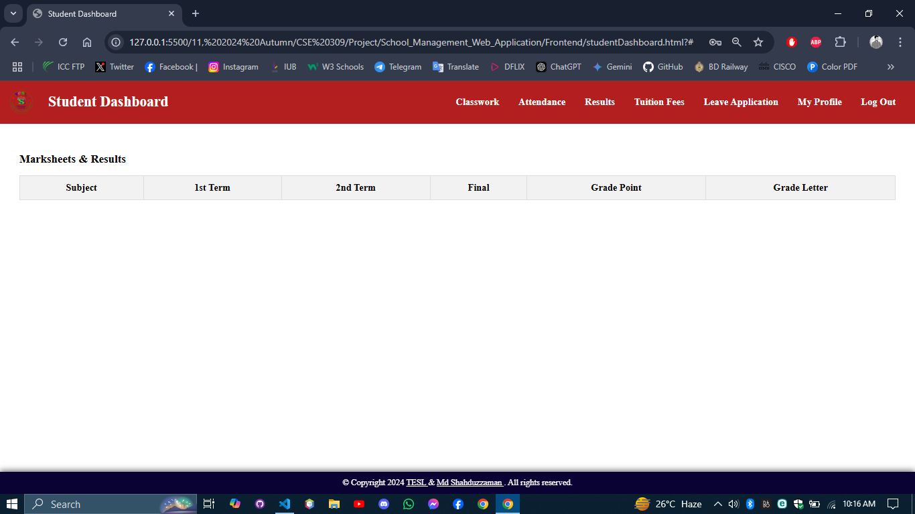
Result: The subject wise result will appear here which is inserted by the specific subject teacher.

Slide 11
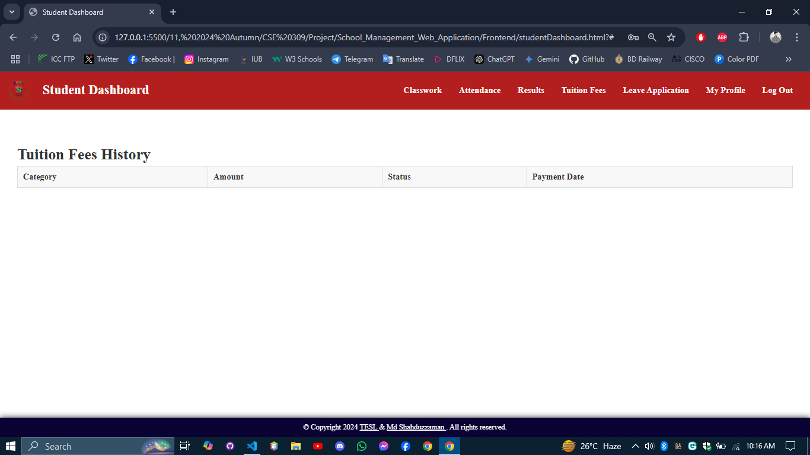
Tuition fees: A table with column consists of Category, Amount, Status (Paid/due), Payment Date(If paid) with the payment records.

Slide 12
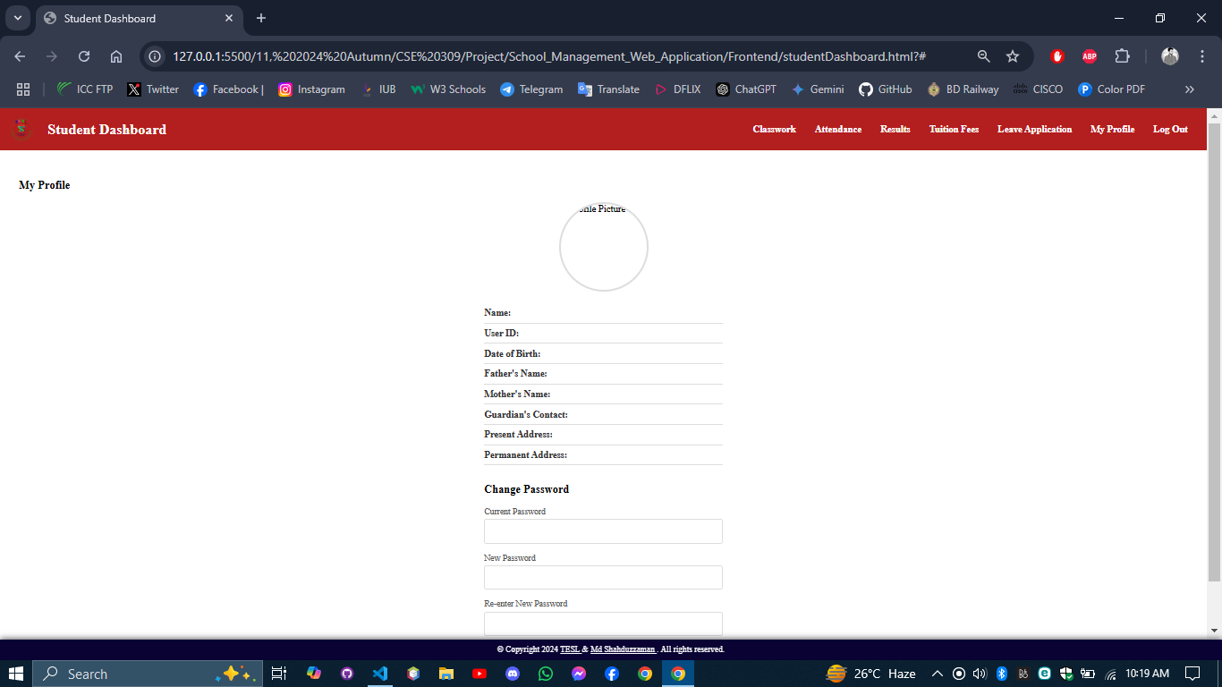
My profile: Profile Picture, Name, User ID, Date of Birth, Father's Name, Mother's Name, Guardian's Contact, Present Address, Permanent Address. Then there will be 3 input boxes for changing Password, they are: Current password, New Password, Re-enter New Password. Then a submit button. By submitting the new password will be replaced with the old password in the database and a message will be shown that “Password change successfully”.

Slide 13
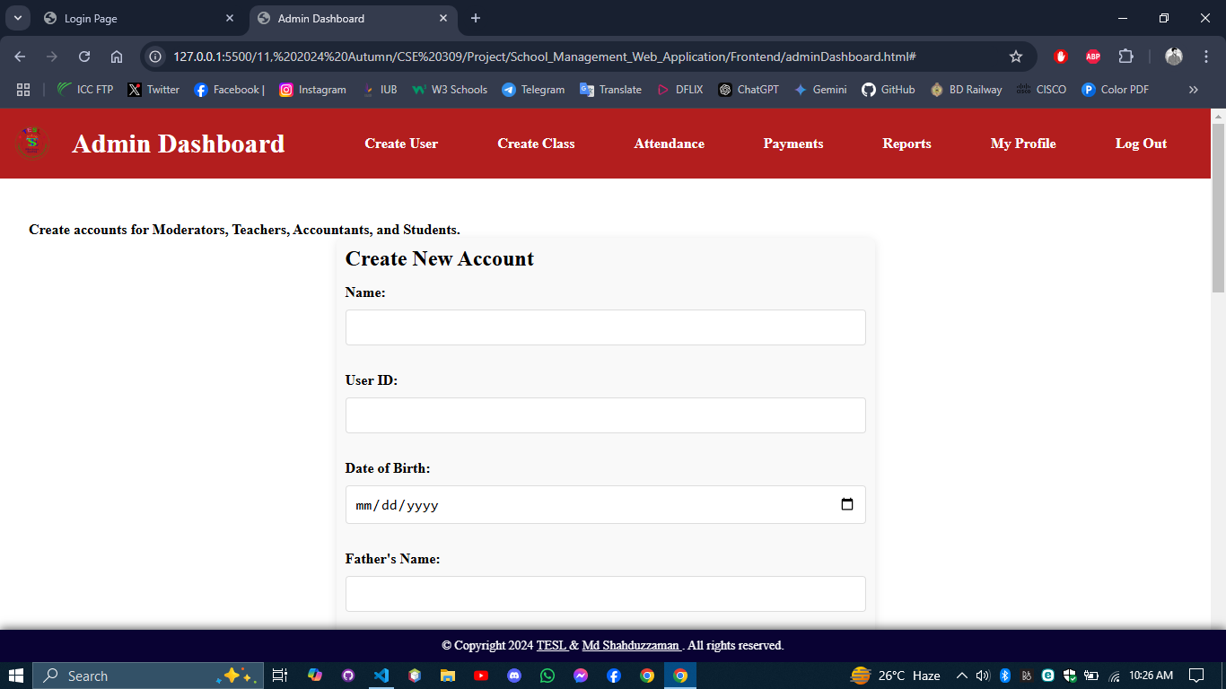
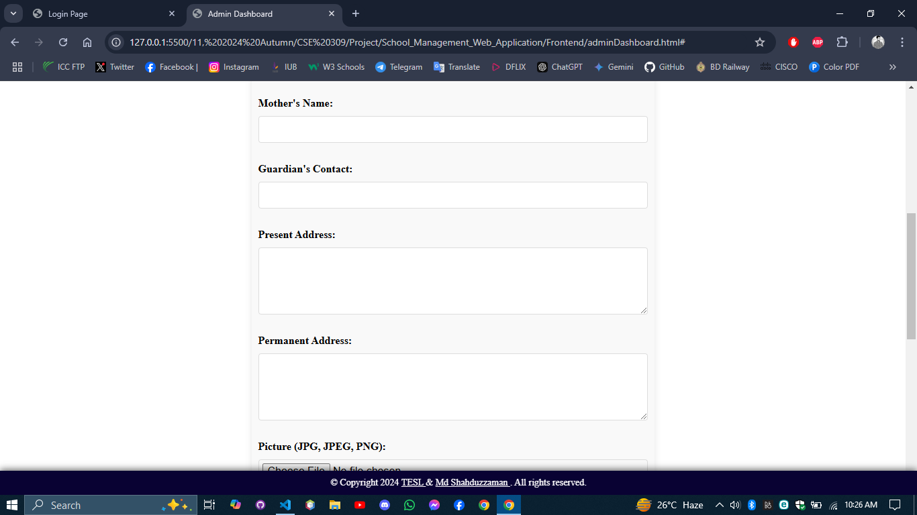
Create user: new user account will be created using the name, UserID, date of birth, father’s name, mother’s name, personal phone number, guardians phone number, present address, permanent address, user’s picture, birth certificate/NID’s pdf, father’s NID pdf, mother NID pdf and a initial password.

Slide 14
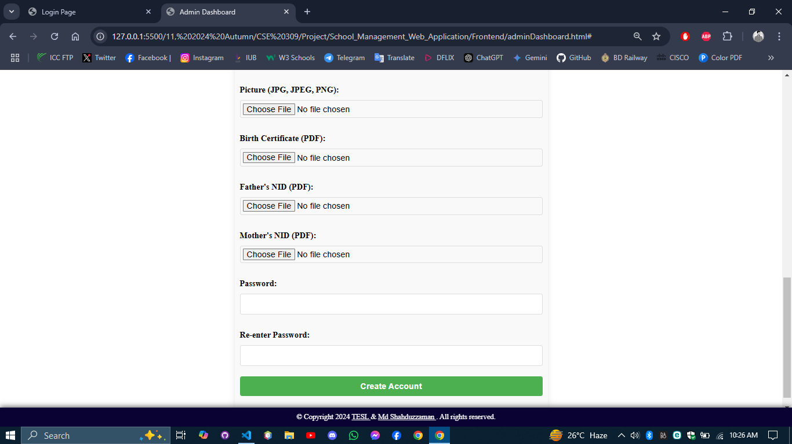

Slide 15
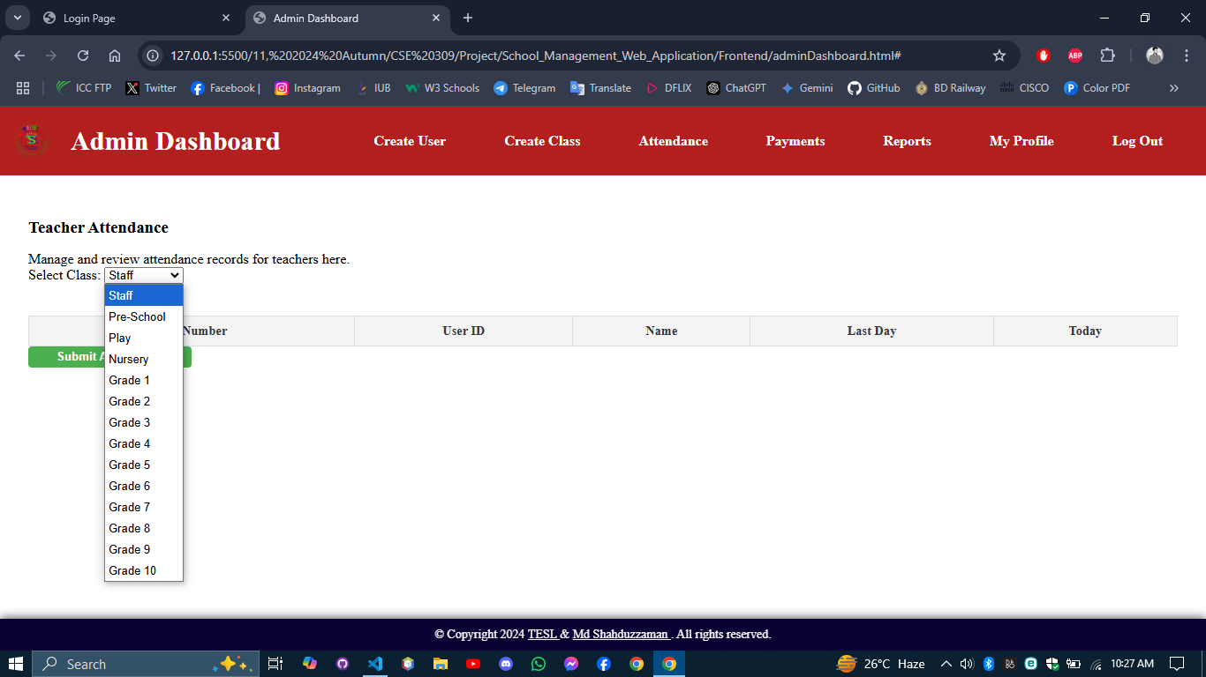
Attendance: There will be a dropdown selection box by which the group will be selected(Example: Staff, class-1, class-2, etc.) then all the users information(Roll Number, User ID, Name, Last Day present or absent, Today(check box)) of that group will appear into a table of 5 column. At the end there is a submit attendance button to submit the todays checked report. Checked report will be saved as “P” and unchecked will be “A”.

Slide 16
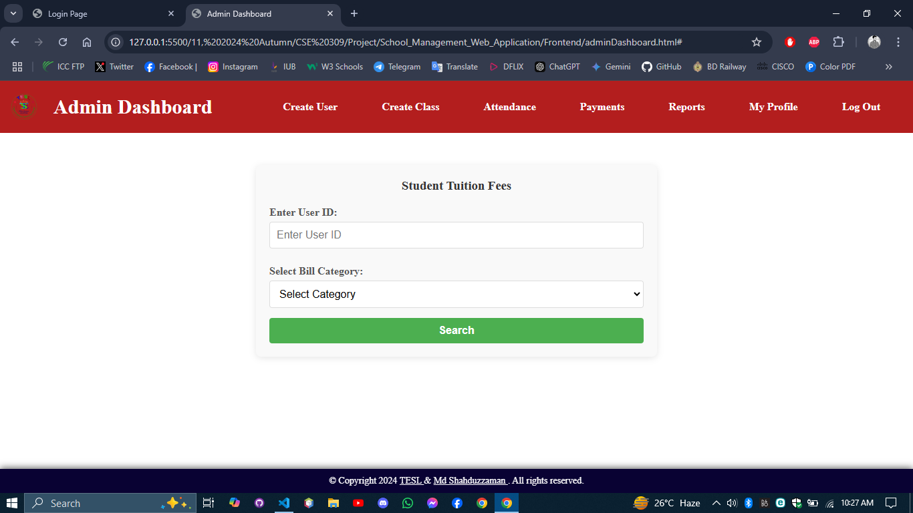
Payments: there will be a input box to enter the user id, a dropdown selection box to select the bill category, a search button will find the id from the database then if that bill is paid there will be a paid message and if not paid then there will be 3 input box for Amount, Payment Status and Payment Date(automatically pick the current date and can be change), then a submit button. By submitting it the data will be stored in the database.

Slide 17
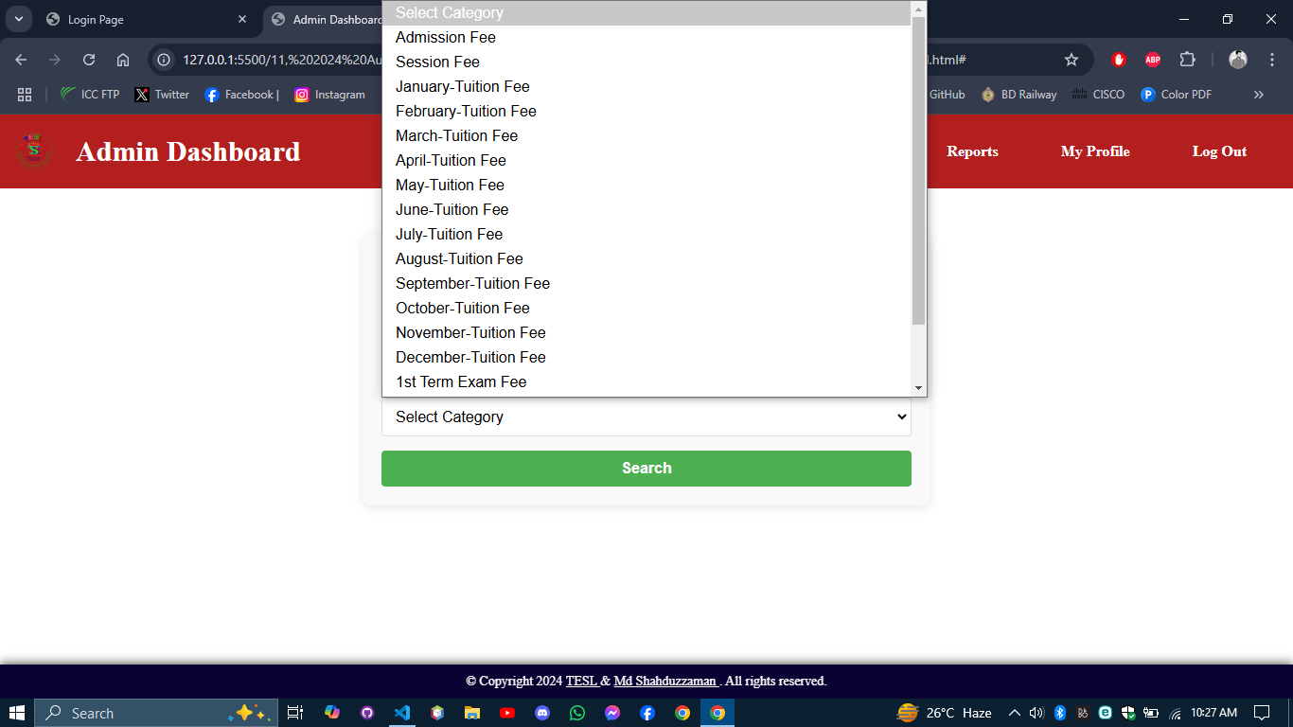

Slide 18
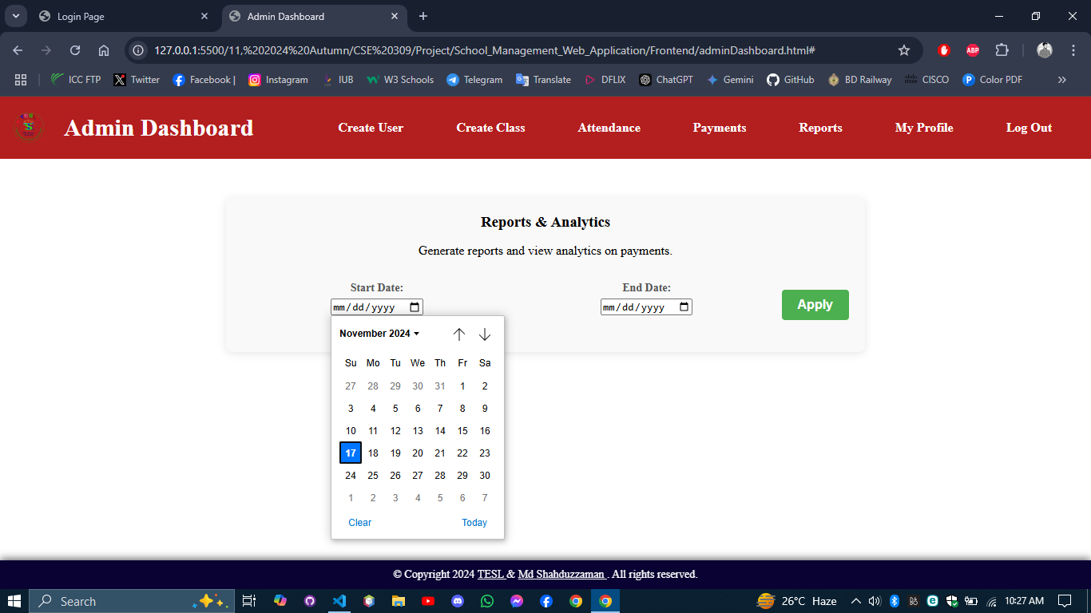
Report: There will be 2 date picker for setting the range and a apply button by which all the payment between the picked date will be shown along with the student user id, category and amount. At the end there will be a summary of that with total payment history appeared and total amount.

Slide 19
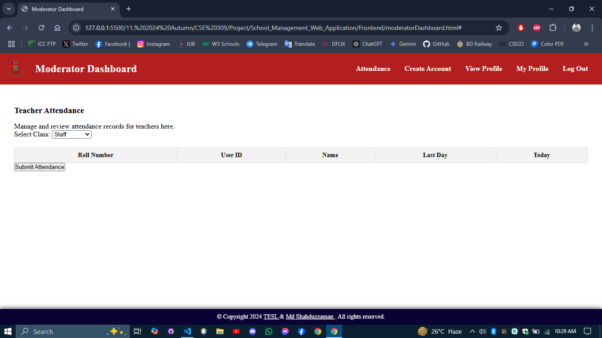

Slide 20
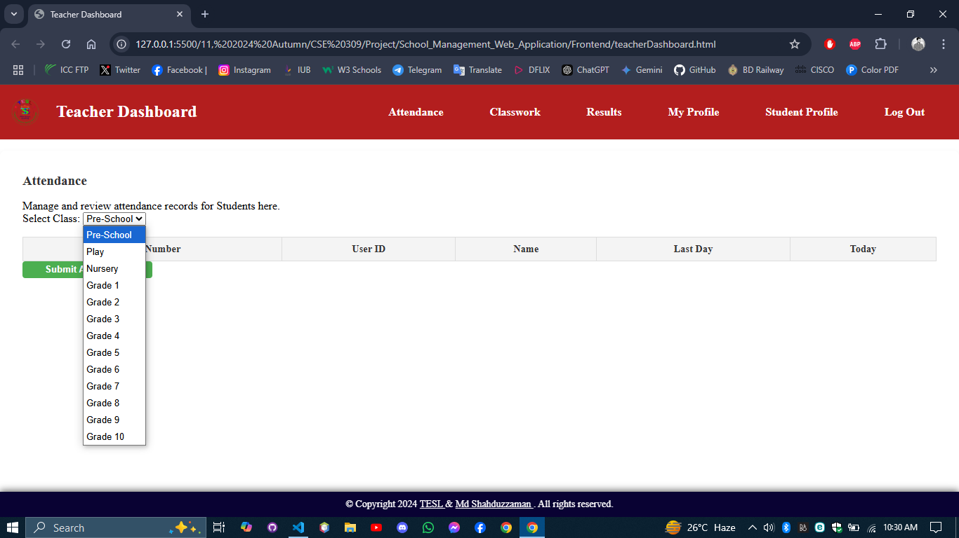

Slide 21
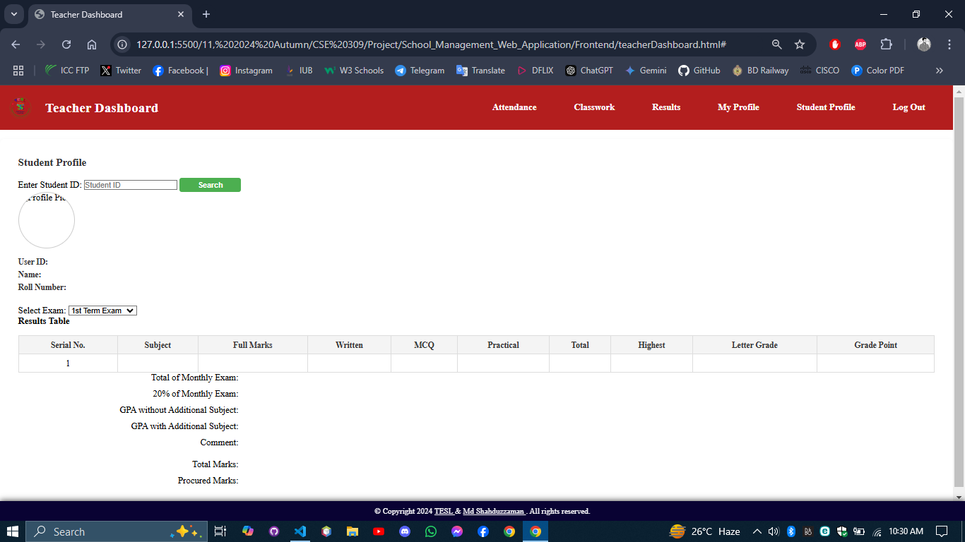
Student Profile: there is a input box to enter the user id and an apply button to load the information. Profile picture, name, roll number and a dropdown selection box to select the result of 1st term, 2nd term or Annul exam is to show. Then the full result of that term will be visible. Result contain Subject, Full Marks, Written, MCQ, Practical, Total, Highest, Letter Grade, Grade Point, Total of Monthly Exam, 20% of Monthly Exam, GPA without Additional Subject, GPA with Additional Subject, Comment, Total Marks, Procured Marks.

Slide 22
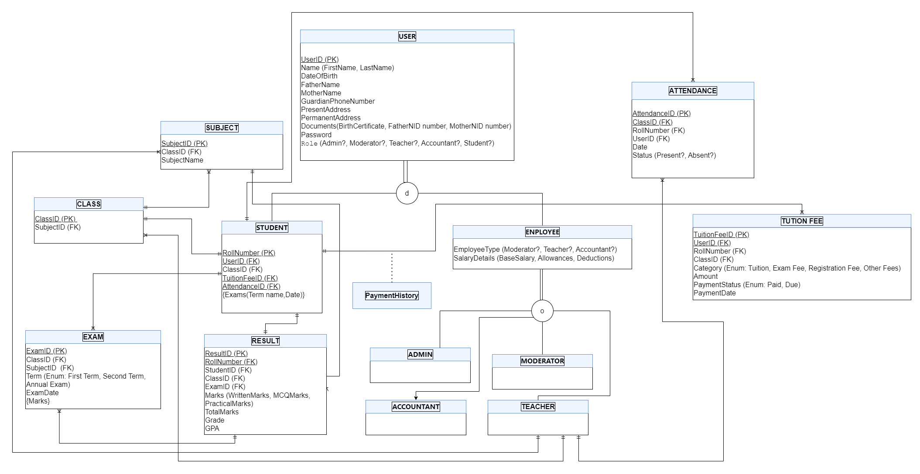

Slide 23
Business Model
A monthly service fee will be included with the tuition fee for each student. This approach ensures that the development and maintenance costs of the system will be recovered within 5 to 6 years.

Slide 24
Competitive Landscape
The neighboring schools are my primary competitors, as they are also striving to enhance their administrative processes and student management systems. To stand out, my project focuses on providing a more comprehensive, user-friendly, and cost-effective solution tailored to the specific needs of both institutions and students.

Slide 25

Md Shahduzzaman Phone: 01790897805 E-mail: mdshahduzzaman@gmail.com
Department of Computer Science and Engineering (CSE),
Independent University of Bangladesh (IUB).
Languages:
Python,
Java,
C++,
JavaScript,
PHP,
HTML,
CSS
Expertise:
Full-Stack Development,
IoT,
Real-Time Software Systems,
Machine Learning Integration,
Project Design & Prototyping

Slide 26
Thank You
Md Shahduzzaman
2131297@iub.edu.bd

